Slide 1
Student Management System
By:
M. Manikandan MCA
mmanikandanmca2023@gmail.com
Language : Java 8
Tools : Visual studio code

Slide 2
Get a data from user like add, Read , Update , Delete or write a output in file .
Step 1: Get a value for how many student added in list
Step 2: Get a value for what work do to .
Step 3: work done
Features:
# User friendly
# Validate user details
# List are printed in file

Slide 3
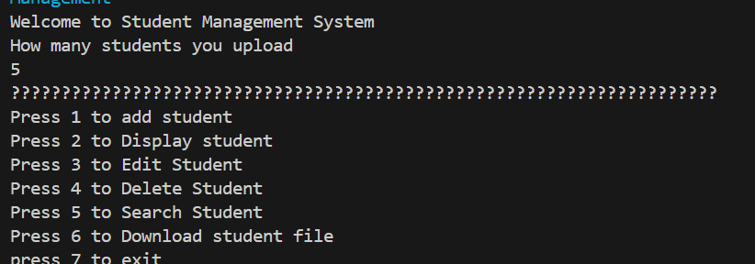
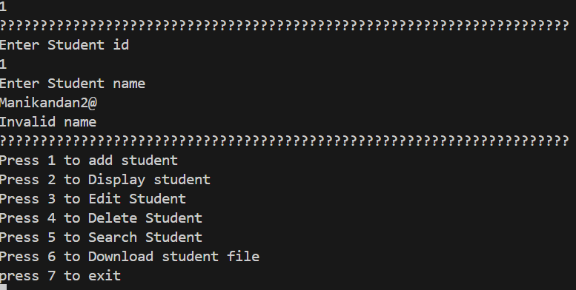
Outputs
GET A DATA FROM USER
VALIDATE A NAME

Slide 4
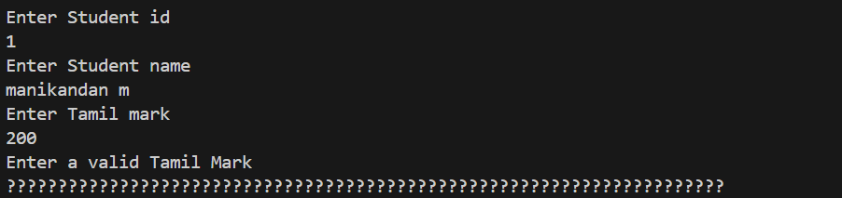
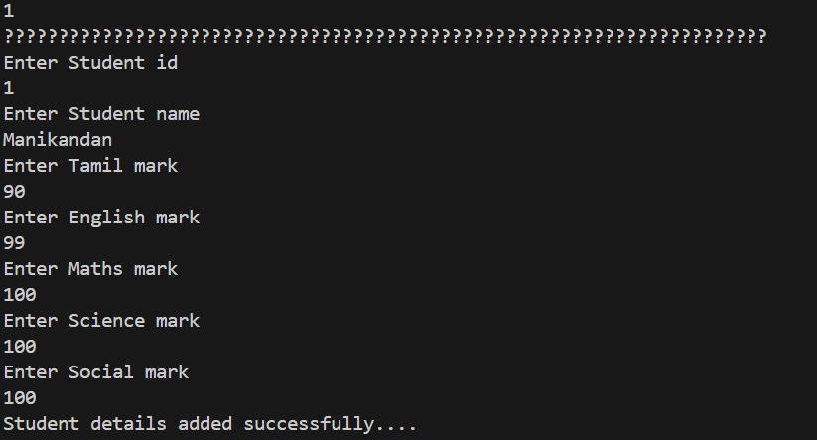
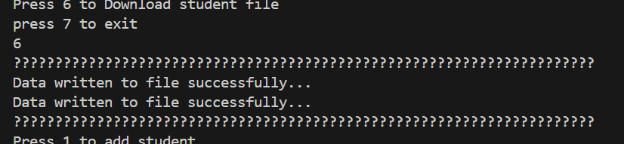
VALIDATE MARK DETAILS
0 TO 100 ONLY ALLOWED
ADD STUDENT
WRITE A FILE

Slide 5
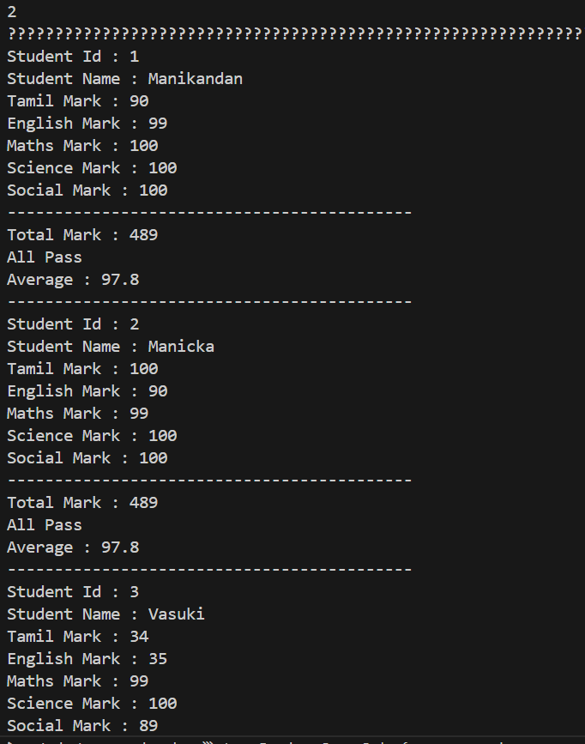
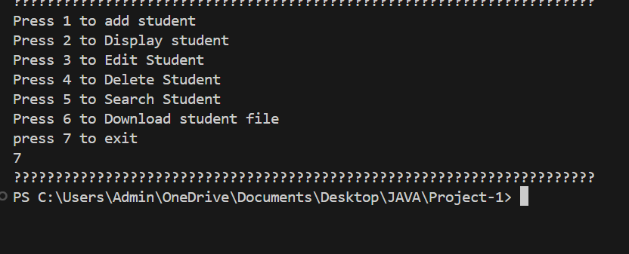
EXIT A SYSTEM
DISPLAY STUDENT LIST

Slide 6
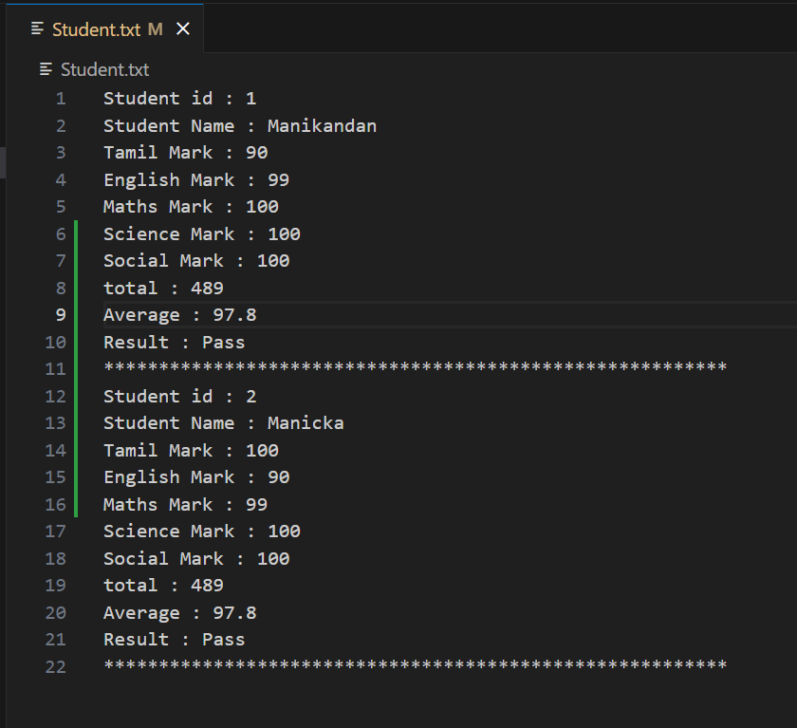
WRITTEN FILE

Slide 7
THANK YOU

